Slide 1
Doctoral Research Project Oral Presentation
Exploring the Role of Cybersecurity Awareness and Training in Enhancing Sustainable Business Performance in Small and Medium-Sized Enterprises: A Qualitative Case Study

Slide 2
Contents
Background to the Study
Problem Statements
Literature Support
Research Framework
Assumptions, Limitations and Delimitations
Research Methodology
Population and Sampling
Data collection and Analysis
Results, Discussion and Implications
Recommendations for Future Research
Closing Remarks

Slide 3
Background to the Study (1)
SMEs: The Backbone of the Global Economy
Represent >90% of businesses worldwide
Key players in supply chains
Digital Transformation – Opportunity & Risk
Cloud computing & digital platforms boost efficiency & competitiveness
Increased cyber vulnerability due to limited awareness of threats & defenses
Cybersecurity Threat Landscape
Only 28% confident in risk management
67% targeted by cyberattacks; 58% breached
~50% lack clear protection strategies
Drive innovation, development, and job creation
Notes:
SMEs are fundamental to the world economy, contributing considerably to development, innovation, and job creation. Representing over 90% of all corporate operations worldwide, SMEs serve as the backbone of economic activity across sectors and regions (Chidukwani et al., 2022).
The swift progression of internet technologies, including cloud computing and digital platforms, has accelerated operational efficiencies for SMEs and enhanced their competitiveness in increasingly digital marketplaces.
However, this digital transformation has introduced a complex array of cybersecurity challenges for SMEs.
A 2018 Ponemon Institute study found that only 28% of SMEs expressed confidence in managing cybersecurity risks, with 67% targeted and 58% experiencing data breaches within the previous year.
Alarmingly, 50% admitted to lacking a clear understanding of how to protect their systems.

Slide 4
Background to the Study (2)
Implications for Supply Chains
SMEs handle sensitive financial/personal data
Persistent Barriers
SME Cybersecurity often underestimated due to limited awareness, funds & skilled personnel
Call to Action
Educate employees, enforce proactive protocols
Breaches can disrupt entire networks & cause financial loss
Strategic investment in resilience & protection
Notes:
The strategic importance of SMEs within supply chains further magnifies the implications of cybersecurity breaches. Many SMEs handle sensitive financial data and personal information on behalf of larger partner organizations, making them attractive entry points for cybercriminals.
A breach at the SME level can compromise the integrity of SMEs and the larger networks that depend on them, resulting in widespread disruptions and financial losses.
Despite the growing threat landscape, SMEs face persistent hurdles in executing efficient cybersecurity measures. Many SMEs underestimate the importance of cybersecurity, often due to limited awareness and restricted financial resources.
To ensure long-term viability and protect sensitive data, SMEs must prioritize cybersecurity through organizational awareness and strategic implementation of robust protective measures.
Educating employees about digital risks and enforcing proactive security protocols are essential to building resilience in a digital environment.

Slide 5
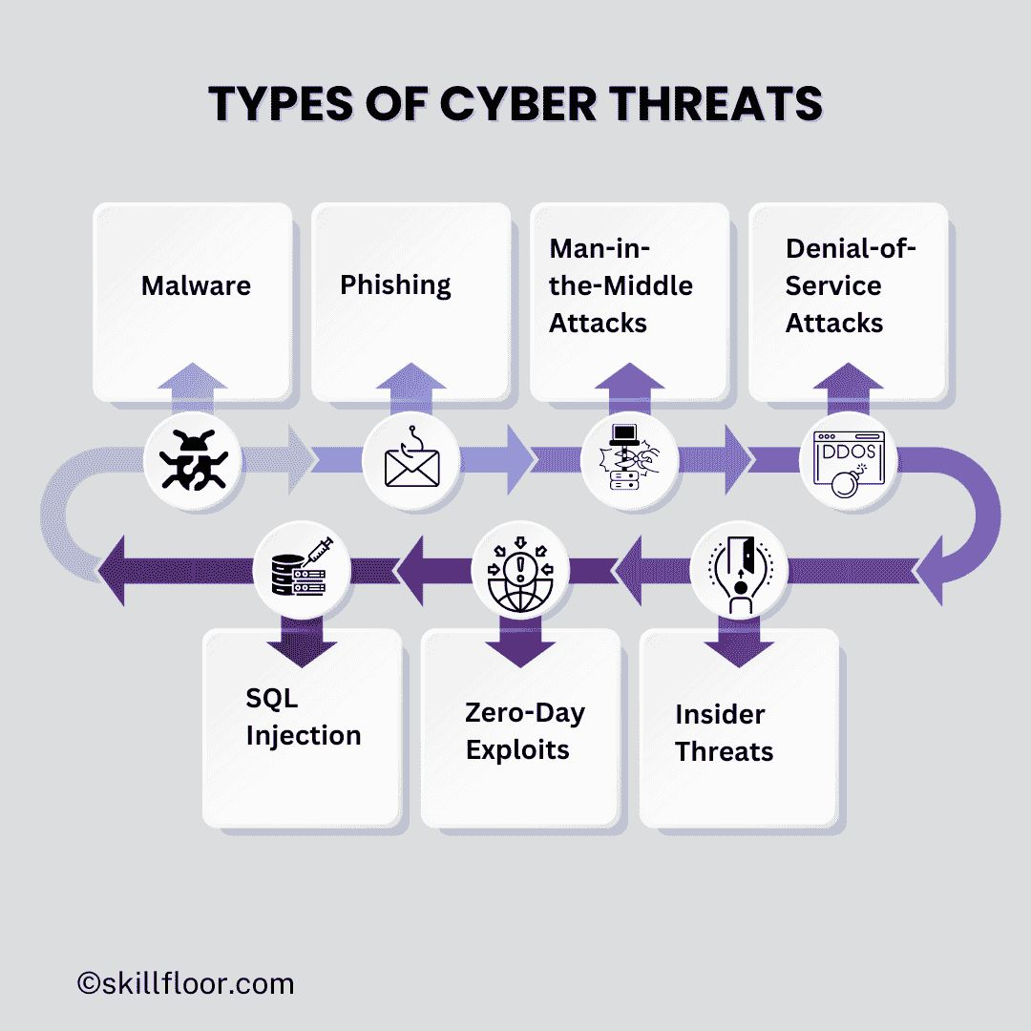
General & Specific Problem Statements
General Problem:
The lack of cybersecurity education and awareness in SMEs heightens vulnerability to cyberattacks capable of disrupting operations and compromising sensitive data.
Specific Problem:
Lack of education and awareness on data security at K2 Partnering Solutions creating vulnerabilities to cyberattacks, risking sensitive information and potentially disrupting operations.
Notes:
The infographic on the right indicates the cyberthreat landscape that many SMEs are unfortunately unaware of.
Many SMEs remain unaware of these threats and often lack sufficient security measures.
Phishing: Phishing attacks deceive individuals into disclosing confidential personal information, including passwords, credit card numbers, and account login details. Phishing attacks, often conducted via deceptive emails, texts, or websites that imitate authentic sources, exploit human trust, rendering them highly successful in compromising security.
Man-in-the-Middle (MitM) Assaults: MitM assaults transpire when an assailant intercepts communication between two entities, frequently without the awareness of either party. This assault may entail intercepting unencrypted Wi-Fi communications or altering data between a user and a website, potentially leading to the theft or modification of sensitive information
SQL Injection: SQL injection uses weaknesses in website databases, enabling attackers to insert harmful SQL commands. If successful, attackers can change, extract, or eliminate vital data, jeopardizing the website's integrity and related information.
Zero-Day Exploits: Zero-day attacks take advantage of previously unidentified weaknesses in software or hardware, which remain unaddressed by the vendor until a corrective update is deployed. The inherent danger of these attacks lies in their ability to leverage unresolved security flaws before any defensive measures can be enacted

Slide 6
Purpose of the Study
• Explore how cybersecurity awareness and training impact sustainable business performance at K2.
• Examine the relationship between management and employee awareness of cybersecurity issues and the effectiveness of current training programs.
• Identify how awareness and training initiatives contribute to the company's long-term success and resilience in a digital marketplace.
• Provide insights for strengthening cybersecurity culture to support sustainable business operations.
Notes:
The purpose of this qualitative study is to explore how cybersecurity awareness and training contribute to the sustainable business performance of K2 Partnering Solutions.
This research examines the relationship between management and employee awareness of cybersecurity issues and the effectiveness of training and awareness programs. It aims to uncover how these factors contribute to the company's long-term success and resilience in an increasingly digital landscape.

Slide 7
Significance of the study
Addresses a critical gap in SME cybersecurity by advancing tailored, evidence-based awareness strategies.
Potential to reduce data breaches, enhance customer trust, and foster a robust security culture.
Provides actionable insights for SMEs with limited resources facing heightened cyber threats.
Notes:
The significance of this study is grounded in its exploration of the critical relationship between cybersecurity awareness and education and their direct impact on the sustainability of small and medium-sized enterprises (SMEs). Many SMEs remain unaware of online threats and often lack sufficient security measures.

Slide 8
Literature Support (1)
The Disproportionate Cyber Risk Facing SMEs
Key Literature Themes:
Targeted Threats: SMEs account for 43% of cyberattacks, underscoring their growing exposure in the digital economy (Verizon, 2023).
Resource Constraints: Unlike large enterprises, SMEs lack dedicated IT teams and advanced security infrastructures, leaving them vulnerable (Rawindaran et al., 2023; Faulhaber-Brad Moon, 2023).
Misconceptions & Complacency: A false sense of security among SME owners contributes to underinvestment in cybersecurity (Arroyabe et al., 2024; Rüdell, 2024).
Supply Chain Risk: SMEs often serve as entry points to larger organizations, amplifying systemic risk across industries (Mugwagwa et al., 2024; Sharma, 2025).
Scholarly Framing:
“The literature consistently identifies SMEs as high-risk entities due to structural vulnerabilities, limited resources, and their strategic position within supply chains.” — Tetteh (2024)

Slide 9
Literature Support (2)
Key Literature Themes:
Human Error as a Core Risk: Poor password hygiene and phishing susceptibility are major breach factors (Javaid et al., 2023; Taherdoost, 2024).
Ineffective Training Models: Static, one-size-fits-all training fails to drive behavioral change (Nurse, 2021; Abrahams et al., 2024).
Need for Adaptive Learning: Gamification, simulations, and personalized feedback are underutilized but promising (Taherdoost, 2024; Prümmer et al., 2024).
Leadership Integration Gap: Despite its importance, leadership involvement in cybersecurity education remains underexplored (Shaw, 2024; Simmons & Sundaresan, 2024).
Scholarly Framing:
“The literature reveals a critical gap in adaptive, leadership-driven cybersecurity education frameworks tailored to SMEs’ unique constraints.” — Abrahams et al. (2024).

Slide 10
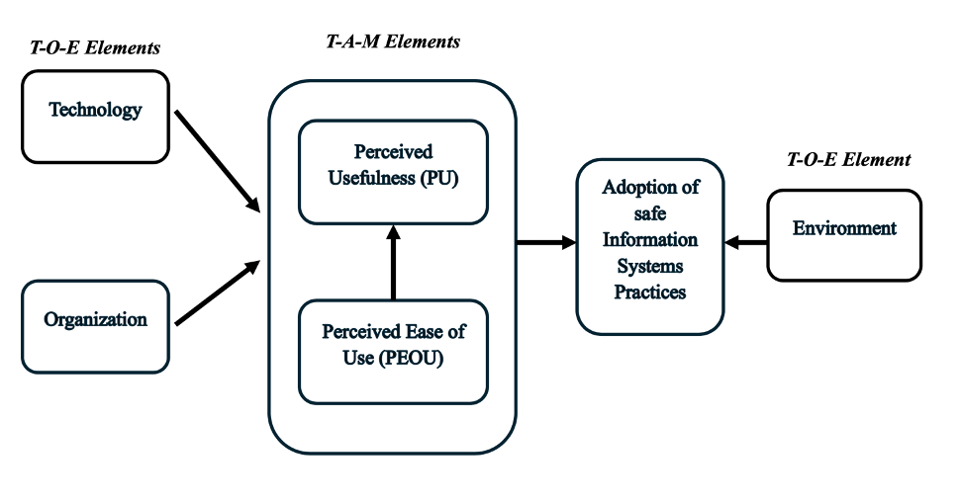
Research Framework
Integrated TOE and TAM Framework
Combines the Technology Acceptance Model (TAM) and the Technology-Organization-Environment (TOE)
Addresses two core SME challenges:
Lack of cybersecurity awareness
Limited resources
Rationale
TAM explains individual adoption behavior
TOE examines organizational and environmental influences
Together → holistic view of cybersecurity adoption in SMEs
Expected Outcomes
Clearer understanding of cybersecurity phenomena in SMEs
Predictive insights for strategic decision-making
Actionable strategies to reduce cyber risks effectively
Figure 1. Integrated TAM-TOE Framework
Source: Gangwar, H., Date, H., & Ramaswamy, R. (2015). Understanding determinants of cloud computing adoption using an integrated TAM-TOE model. J. Enterp. Inf. Manag., 28, 107-130.
Notes:
Developed by Fred Davis in the 1980s, the Technology Acceptance Model (TAM) explains technology adoption by linking users’ behavioral intentions to two key factors: perceived usefulness (PU)—how much they believe it improves performance—and perceived ease of use (PEOU)—how effortless it seems to operate. Together, these shape attitudes and drive adoption decisions.
The TAM framework thoroughly explains how users interact with emerging technologies.
TAM helps organizations design pre-implementation strategies that boost user acceptance and improve system performance.
TAM’s principles can be applied to cybersecurity training.
A strong security culture is vital for effective organizational defense.
Comprehensive training programs prepare employees to detect and respond to threats.
Training equips staff to counter common cyber risks such as phishing, ransomware, and social engineering.
The Technology-Organization-Environment (TOE) framework explains how organizations adopt and integrate technological innovations by examining three interconnected contexts:
Technological context – factors such as innovation attributes, integration, ease of use, trialability, complexity, and direct benefits.
Organizational context – internal elements like financial resources, structure, leadership support, innovation capacity, human capital quality, infrastructure, and readiness.
Environmental context – external influences including industry dynamics, government incentives, and market changes.
The combined TOE-TAM framework is useful as a research model because it offers a holistic lens that links technology adoption factors with organizational, environmental, and human acceptance elements. This integration enables researchers to examine both the structural conditions for technology implementation and the behavioral drivers influencing user uptake, making it well-suited for studying complex issues like cybersecurity in SMEs.

Slide 11
Assumptions, Limitations and Delimitations
Assumptions
K2 faces notable cyber challenges
Limitations
Small sample size (10 stakeholders)
Delimitations
Focused on K2 only
Limited access to proprietary data
Interpretive nature of qualitative research leading to interviewer bias
Internal practices & awareness—no vendor risk analysis
Five-year timeframe for threat relevance
Qualitative scope over quantitative generalization
Selected participants have relevant knowledge
Documents are accurate, up-to-date & accessible
Notes:
Assumptions: This study assumes that K2 Partnering Solutions has faced significant cybersecurity challenges that can be effectively analyzed through the perspectives of relevant stakeholders.
Study assumes that participants, chosen through purposeful sampling, possess the requisite knowledge to offer precise, comprehensive insights into the organization’s cybersecurity strategies and awareness initiatives.
Limitations:
A significant constraint of this study is its small sample size, confined to 10 stakeholders within one organization.
This may restrict the generalizability of the findings to other SMEs, though qualitative research prioritizes depth over breadth.
Another limitation is restricted access to proprietary cybersecurity data, which may limit the study's ability to explore internal incidents and response strategies fully.
The interpretive nature of qualitative research can introduce interviewer bias, potentially impacting data analysis.
Delimitations:
This study is delimited to K2 Partnering Solutions, deliberately excluding comparisons with other organizations to enable a context-specific, in-depth analysis - inherently restricts the applicability of findings to other SMEs.
The study focuses on internal cybersecurity practices and employee awareness, excluding external factors like third-party vendor protocols and supply chain vulnerabilities.
The study focuses on cybersecurity developments from the past five years for relevance, but this may omit long-term trends or legacy issues.
The study uses a qualitative approach, emphasizing stakeholder perceptions and organizational culture, offering deep insights but limiting statistical generalizability.

Slide 12
Research Methodology (1)
Qualitative Approach
Qualitative methods provide deep insights into organizational behaviors and security practices (Goldberg & Allen, 2015).
Case study of an SME’s cybersecurity posture to uncover vulnerabilities, risk perceptions, and mitigation strategies.
Focus on the complex interaction of technology, human, and organizational factors.
Purposive Sampling
Targets key stakeholders: IT personnel, executives, frontline employees.
Ensures perspectives from those directly involved in cybersecurity decision-making.
Facilitates rich, multi-dimensional understanding of cybersecurity strategies.
Notes:
This study applies a qualitative case analysis of an SME to identify vulnerabilities, assess risk perceptions, and explore mitigation strategies.
Qualitative research is essential in cybersecurity for understanding organizational behaviors and practices. Case studies provide rich, context-specific insights into technological, human, and organizational interactions.
The study uses purposive sampling to select K2 Partnering Solutions employees with direct experience in cybersecurity training, ensuring insights into how cybersecurity awareness influences SME resilience and business performance.

Slide 13
Research Methodology (2)
Mixed-Methods Data Collection
Combines semi-structured interviews, online surveys, and document analysis.
Aligns with best practices in cybersecurity research (Yin, 2018).
Enables a holistic view of cybersecurity dynamics within the SME.
Triangulation for Trustworthiness
Cross-verifies data from multiple sources to enhance reliability and validity.
Strengthens confidence in findings through diverse evidence.
Contribution
Offers actionable insights to improve SME cybersecurity frameworks.
Bridges academic knowledge with practical security improvements.
Notes:
The study uses a triangulated data collection approach—semi-structured interviews, online surveys, and document analysis—to gain a comprehensive understanding of cybersecurity awareness in SMEs. This method allows for in-depth insights from directly involved employees, broader patterns from surveys, and contextual information from organizational documents.
Combining these methods enhances analytical robustness, reduces bias, and provides practical, nuanced, and actionable insights into how cybersecurity awareness affects SME resilience, employee behavior, and business performance.

Slide 14
Population and Sampling
Study Population: Broad group relevant to cybersecurity in SMEs.
Target Population: Employees at K2 Partnering Solutions, directly impacted by cybersecurity.
Significance:
Focused on accessible, relevant participants to ensure meaningful insights.
Aims to inform K2 Partnering Solutions and offer guidance applicable to similar SMEs navigating cybersecurity challenges.
Notes:
The study distinguishes between the broader study population (SMEs affected by cybersecurity challenges) and the target population (employees of K2 Partnering Solutions directly involved in cybersecurity training).
Focusing on this specific group ensures relevance, accessibility, and meaningful insights into how cybersecurity awareness and training contribute to SME resilience and business success, with implications applicable to similar organizations.

Slide 15
Data Collection and Analysis (1)
Triangulated Data Collection:
Semi-structured Interviews
10–15 minutes, flexible format, audio recorded.
Purposive sample of 10 participants across departments and hierarchy
Online Surveys
Mix of open & closed questions
Ensures anonymity, accessibility, and candid responses.
Document Analysis
Review of policies, training logs, and incident reports.
Provides critical contextual depth.
Notes:
The study employed a triangulated data collection approach using semi-structured interviews, an online survey, and a document review checklist to examine organizational cybersecurity practices comprehensively.
Interviews capture rich, experience-based narratives, the survey provides both qualitative and quantitative insights, and document review offers contextual information from policies and reports.
This multi-method strategy enhances methodological rigor, credibility, and validity by cross-verifying data from multiple sources.

Slide 16
Data Collection and Analysis (2)
Data Analysis
Thematic Analysis Framework
Braun & Clarke’s 6-step process to identify key themes from textual data.
Coding phases: open coding → axial coding → theme development.
Example themes: Cybersecurity Awareness, Training Effectiveness, Policy Enforcement.
Analysis Process
Coding of interviews, surveys, and documents to reveal patterns (e.g., “fragmented cybersecurity culture”).
Thematic maps visualize relationships among themes.
Findings linked to research questions and existing literature for rich interpretation.
Triangulation for Validity
Cross-verification of data from interviews, surveys, and documents.
Enhances credibility and reduces bias (Fusch et al., 2018).
Ensures a comprehensive and trustworthy understanding of cybersecurity culture and practices.
Notes:
The study employed thematic analysis to examine qualitative data from interviews, surveys, and document reviews, identifying patterns and recurring themes.
The process includes open coding to capture initial concepts and axial coding to group them into broader themes such as cybersecurity awareness, training effectiveness, and policy enforcement.
Visual thematic maps will illustrate connections between categories, and findings will be interpreted in relation to the research questions and existing literature to provide a nuanced understanding of organizational cybersecurity practices.

Slide 17

Results, Discussion and Implications (1)
Thematic Analysis
Four themes emerged:
Organizational Cybersecurity Strategies and Infrastructure
Cybersecurity Awareness and Training Culture
Cybersecurity Culture and Organizational Commitment
Sustainability and Strategic Impact

Slide 18
Results, Discussion and Implications (1)
Research Questions
RQ1: What strategies and measures does K2 Partnering Solutions employ to mitigate and counter potential cyber threats to its systems and data?
RQ2: What strategies does K2 Partnering Solutions implement to raise employee awareness and provide training to protect the business from potential cyberattacks?
Thematic Analysis
Four themes emerged:
Organizational Cybersecurity Strategies and Infrastructure
Cybersecurity Awareness and Training Culture
Cybersecurity Culture and Organizational Commitment
Sustainability and Strategic Impact
Notes:
Research Questions and Themes
The research questions guided the formulation of the key themes, ensuring alignment with the study’s focus on cybersecurity strategies and employee awareness.
Key Themes Identified:
Organizational Cybersecurity Strategies and Infrastructure – Policies, frameworks, and technologies to reduce cyber risk.
Cybersecurity Awareness and Training Culture – Scope, frequency, and effectiveness of employee training initiatives.
Cybersecurity Culture and Organizational Commitment – Leadership involvement and cross-functional engagement supporting both strategy and training.
Sustainability and Strategic Impact – Alignment of cybersecurity efforts with long-term organizational goals and resilience.

Slide 19
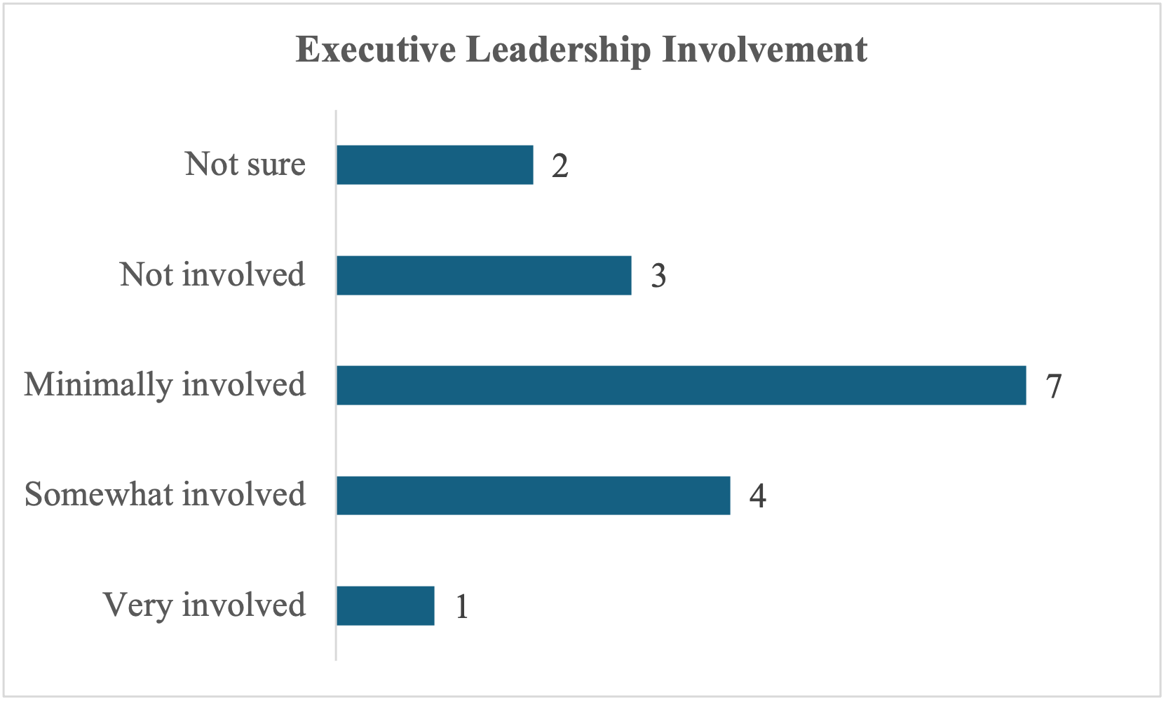
Results, Discussion & Implications (2)
Theme 1: Organizational Cybersecurity Strategies & Infrastructure
Key Threats:
Phishing & impersonation emails widespread
Reactive approach via informal alerts (Slack)
Policies & Tech:
ISO/IEC 27001 framework adopted but poorly communicated
Basic defenses: spam filters, 2FA; no advanced threat detection
Leadership Involvement:
Formal policy endorsed, but low visible engagement
Leadership Involvement perceived as weak across
Disconnect limits strategic cybersecurity integration
Survey Data
Notes:
Results:
Perceived Cyber Threats: Employees consistently identified phishing and impersonation attacks as the most common threats, highlighting organizational susceptibility to social engineering despite no major breaches. Responses indicated a reactive approach, with alerts communicated informally through internal channels like Slack.
Cybersecurity Policies and Protocols: While K2 aligns with ISO/IEC 27001 standards for external contractors, internal awareness and adherence to policies were inconsistent. Employees reported uncertainty about reporting procedures and limited exposure to structured training programs.
Technology Utilization: The organization relies primarily on foundational security tools such as spam filters, two-factor authentication, and CRM security settings. Advanced proactive measures like SIEM, EDR, or AI-driven threat detection were largely absent.
Management Involvement: Executive engagement was perceived as minimal. Survey and interview data indicated a disconnect between formal policy endorsement and visible leadership involvement, undermining organizational cybersecurity culture.

Slide 20
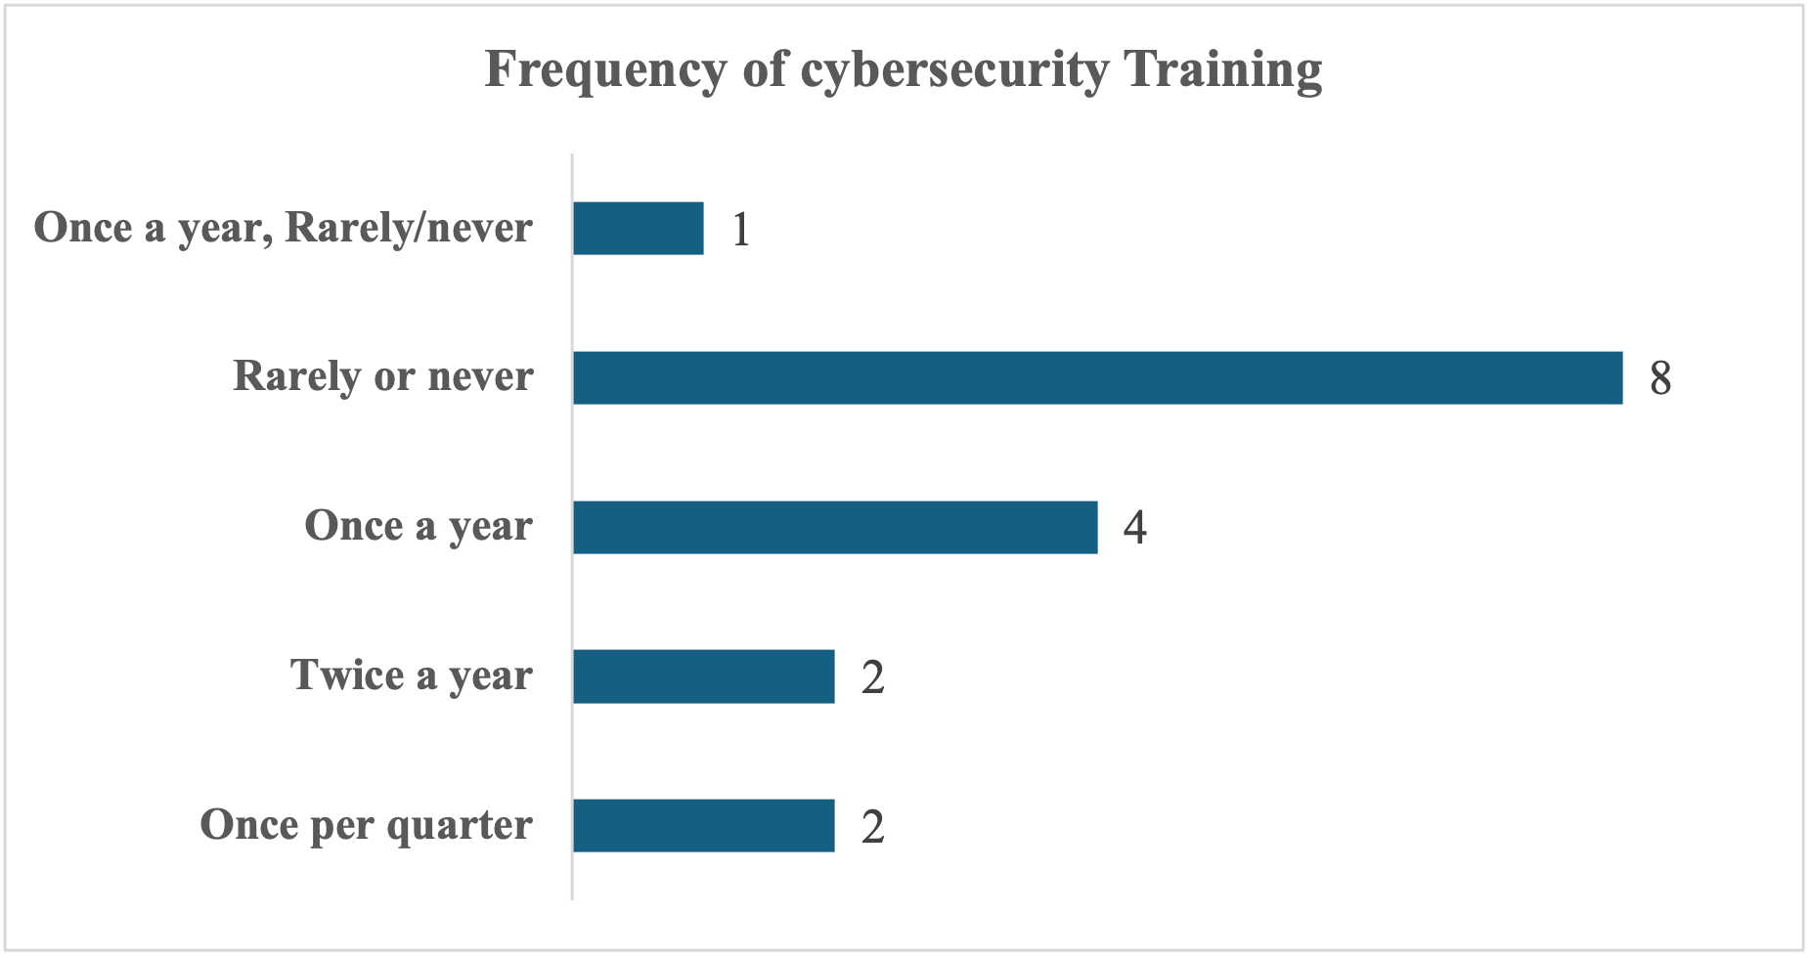
Results, Discussion & Implications (3)
Theme 2: Awareness & Training Culture
Survey Data
Training Delivery & Effectiveness:
Over 50% rarely or never trained; onboarding often the only exposure
44% rated training as only moderately effective
Implications:
Implement structured, recurring training programs
Use experiential learning (simulations, case studies) over passive formats
Introduce evaluation metrics (quizzes, follow-ups) to measure training impact
Notes:
Theme 2 – Cybersecurity Awareness and Training Culture: Concise Summary
Results: Cybersecurity training at K2 is minimal, mostly limited to onboarding. Interactive methods like phishing simulations are more effective than passive communications, but overall engagement is reactive, with only 31% reporting threats. Structural barriers—time constraints, low prioritization, and sales-focused culture—further limit participation. No formal evaluation or feedback mechanisms exist to measure or improve training outcomes.
Discussions: The lack of ongoing, structured training weakens cybersecurity culture and employee readiness. Sporadic, passive communication fails to build confidence or retention, while reactive engagement highlights gaps between policy and practice. Organizational pace and competing priorities hinder consistent training integration.
Implications: K2 should implement continuous, interactive training reinforced by leadership, embedded into workflows, and supported by evaluation tools and feedback loops. Strengthening these areas is essential to build a proactive cybersecurity culture and reduce employee vulnerability to threats.

Slide 21
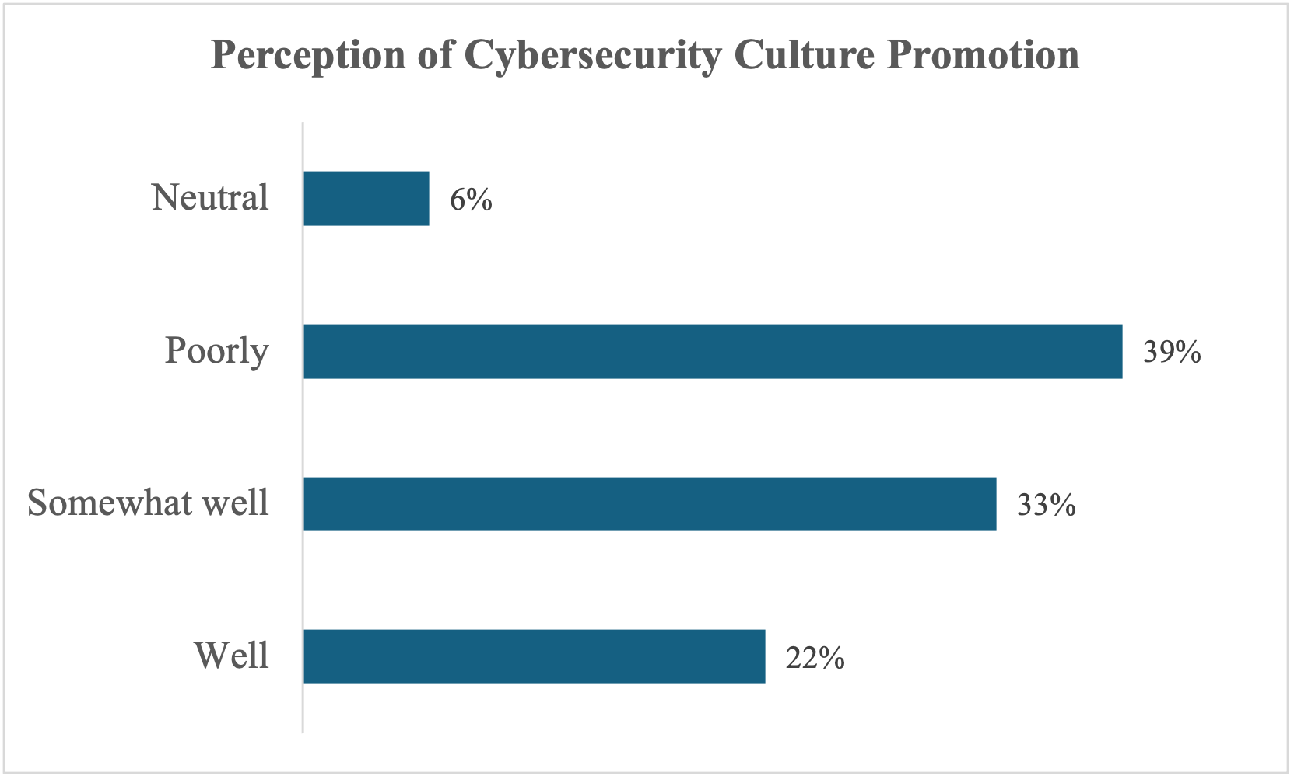
Results, Discussion & Implications (4)
Theme 3: Cybersecurity Culture & Commitment
Only 22% say cybersecurity culture promoted effectively
Leadership support procedural, not participatory
Lack of visible campaigns, drills, peer support
Implications:
Leadership must role-model secure behaviors
Launch organization-wide awareness campaigns
Encourage cross-functional, peer-led security initiatives
Survey Data
Notes:
Theme 3 – Cybersecurity Culture and Organizational Commitment: Summary
Results: Leadership at K2 is largely disengaged from cybersecurity, which is perceived as reactive and compliance-driven. Only a minority of employees (22%) view cybersecurity culture as well-promoted, and resource access and support are limited.
Discussions: The lack of visible leadership and structured cultural initiatives weakens proactive security behaviors. Employees are willing to engage but lack consistent guidance and reinforcement.
Implications: Strengthening leadership involvement, providing accessible resources, and embedding cybersecurity into everyday culture are essential to building ownership, improving awareness, and reducing organizational risk.

Slide 22
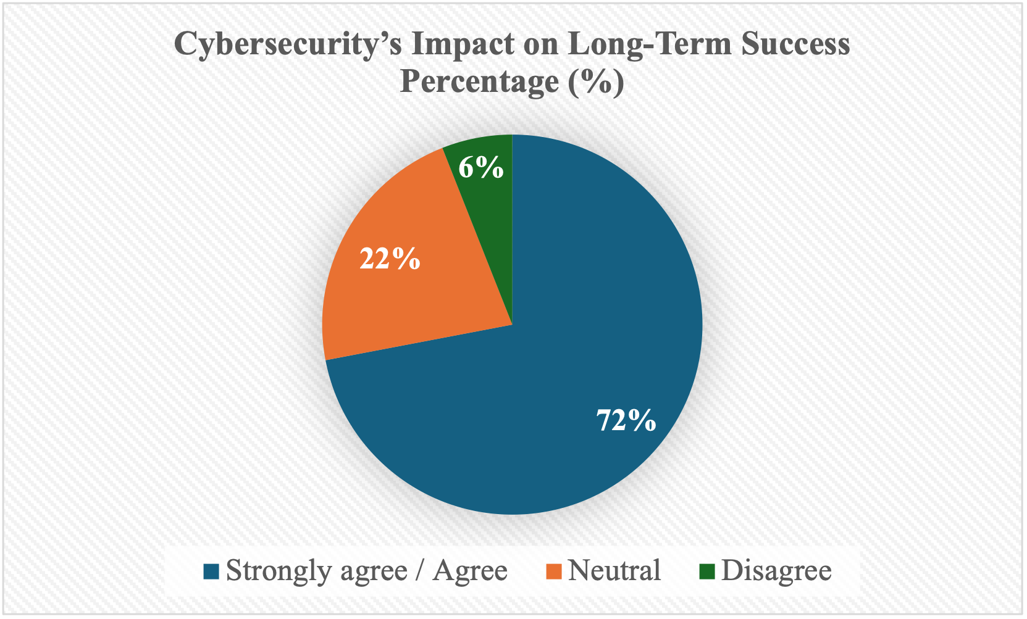
Results, Discussion & Implications (5)
Theme 4: Sustainability & Strategic Impact
Strategic Recognition
72% agree cybersecurity affects long-term success
Strategic opportunity: integrate security into business continuity
Contractor model makes security critical
Implications:
Cybersecurity must shift from reactive to proactive strategic pillar
Leadership engagement & culture-building essential for resilience
Systematic training, continuous improvement, and compliance audits needed
Notes:
Results: Employees recognize cybersecurity as critical to K2’s long-term success, with 72% linking awareness to sustainable business outcomes. However, formal alignment of cybersecurity with business performance metrics or KPIs is lacking.
Discussions: Despite intuitive understanding of its strategic value, cybersecurity remains siloed from enterprise-level planning. Employees advocate for innovative, role-specific, and experiential training—such as phishing simulations, real-world scenarios, and periodic refreshers—to reinforce skills and support continuous improvement.
Implications: To leverage cybersecurity as a pillar of organizational sustainability, K2 should integrate it into strategic planning, establish performance metrics, and implement continuous, adaptive training. Embedding cybersecurity as a proactive enabler enhances resilience, trust, and competitive advantage while supporting long-term business continuity.

Slide 23
Recommendations for Future Research
Key Directions for Future Research
Advancing Cybersecurity Research in SMEs
Longitudinal & Comparative Studies
Track culture, leadership, and training impact over time.
Compare SMEs across industries/regions to identify context-specific maturity drivers.
Socio-Technical & Leadership Dynamics
Examine informal communication (e.g., Slack) as agile awareness channels.
Investigate executive decision-making, risk perception, and tech adoption barriers.
Innovative Training & Governance Models
Test gamified, scenario-based training for behavioral impact.
Integrate cybersecurity into enterprise risk management and cultural norms.
Notes:
Recommendations for Future Research – Presentation Summary
Future research should use longitudinal and mixed-methods approaches to track cybersecurity culture, leadership engagement, and training effectiveness over time. Comparative studies across industries and regions can reveal contextual factors shaping SME cybersecurity maturity.
The role of informal communication platforms, leadership decision-making, and organizational barriers to adopting advanced security tools warrants deeper investigation. Experimental studies on gamified, scenario-based, and adaptive training can evaluate methods that improve threat recognition, knowledge retention, and secure behaviors.
Research should also explore integrative governance models that align cybersecurity with enterprise strategy, leadership accountability, and cultural norms. Multidisciplinary studies combining technological, behavioral, and organizational perspectives can guide SMEs from reactive to proactive cybersecurity practices, fostering a resilient, sustainable security culture.

Slide 24
Closing Remarks
Cybersecurity is integral to SME sustainability in the digital economy.
01
Education and awareness serve as the most cost-effective and impactful defenses.
02
This study contributes actionable, context-specific strategies to strengthen SME resilience.
03
A proactive cybersecurity culture safeguards operational continuity and stakeholder trust.
04

Slide 25
Acknowledgments
My deepest gratitude to my outstanding Dissertation Chair, Dr. Pedro Nunes, for his unwavering guidance, exceptional patience, and invaluable expertise that greatly contributed to this work.
Sincere appreciation to my Committee Members for their thoughtful feedback and encouragement
Heartfelt appreciation to Ivet Rodriguez, my Student Success Advisor, and to all Faculty and Staff for their steadfast support throughout this journey.

Slide 26
Q & As

